Slide 1
Lead Score Case Study
Komal Suthar
Kishor Mahajan
Kavitha

Slide 2
Problem Statement
X Education sells online courses to industry professionals.
X Education gets a lot of leads, but lead conversion rate is very poor. For example, they acquire 100 leads in a day, only about 30 of them are converted.
To make this process more efficient, the company wants to identify the most potential leads, also known as ‘Hot Leads’.
If they successfully identify this set of leads, the lead conversion rate should go up as the sales team will now be focusing more on communicating with the potential leads rather than making calls to everyone.

Slide 3
Business Objective
X education wants to know most promising leads.
For that they want to build a Model which identifies the hot leads.
Deployment of the model for the future use.

Slide 4
Solution Methodology
Import Libraries and Read Data
Import libraries like numpy, pandas, sklearn, matplotlib, seaborn, statsmodels etc and read csv file.
Data Understanding and Inspection
Understand basic data for Analysis.
Data Cleaning
Drop columns, if it contains large amount of missing values.
Drop unnecessary columns.
Remove variable which have imbalance data.
Imputation of the values, if necessary.
Fixed Invalid values & Standardising Data.
Check and handle outliers in data.

Slide 5
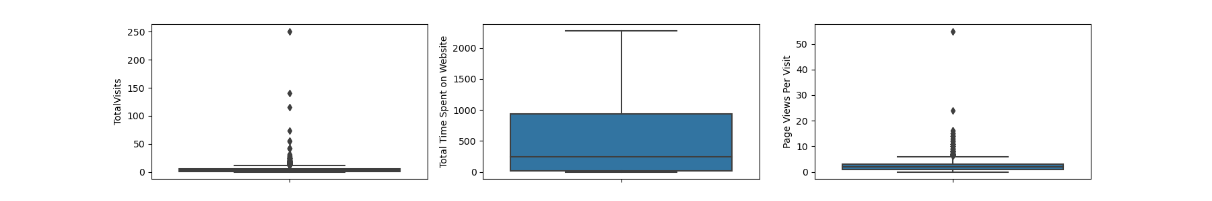
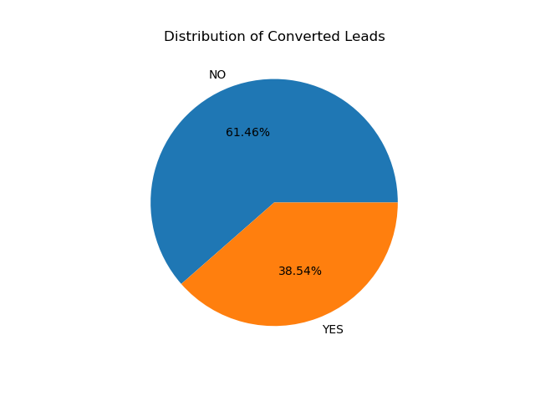
Solution Methodology
EDA
Check Data Imbalance.
Univariate data analysis.
Bivariate data analysis.
Multivariate analysis: correlation coefficients

Slide 6
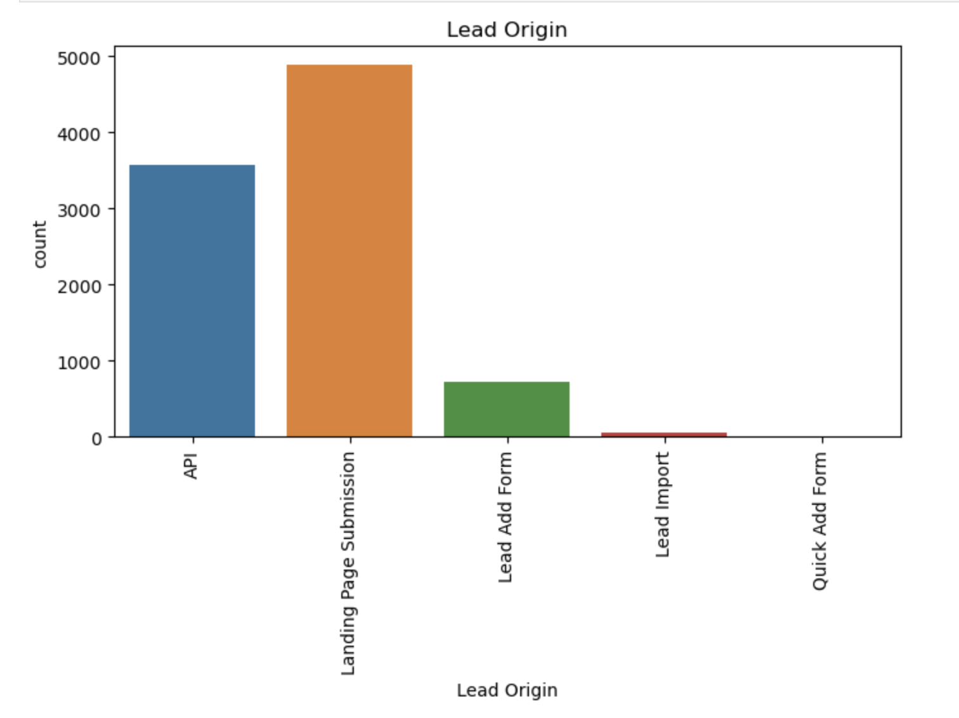
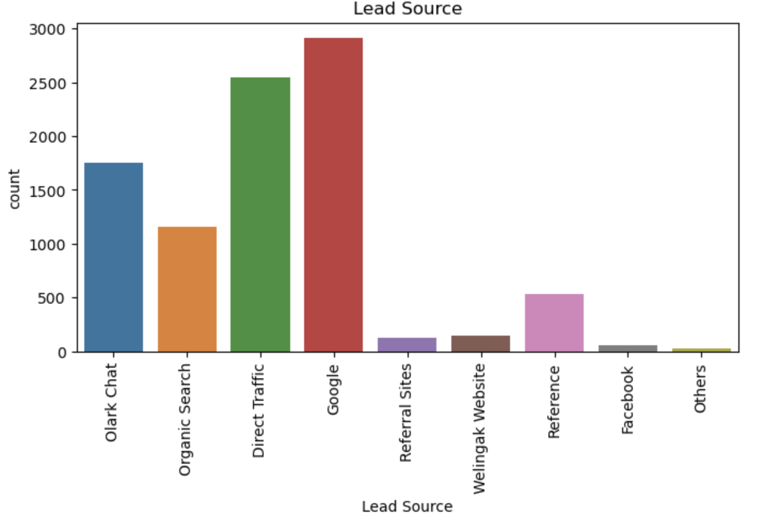
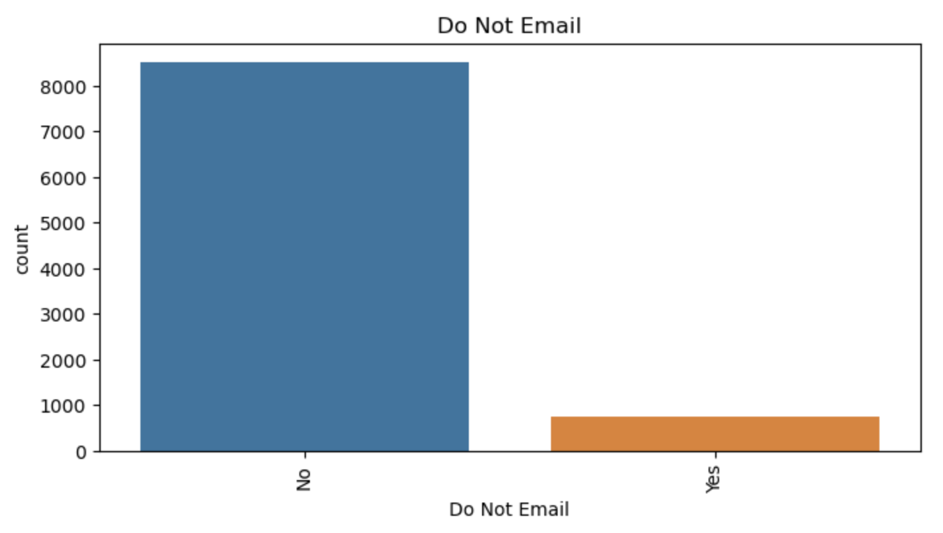
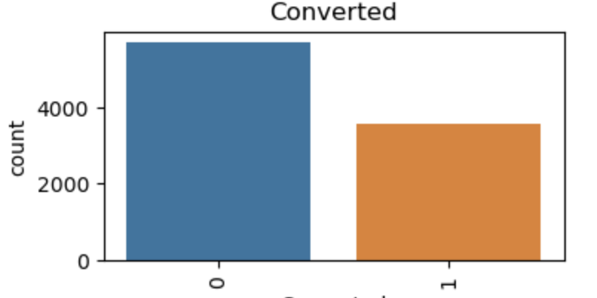
Univariate Analysis

Slide 7
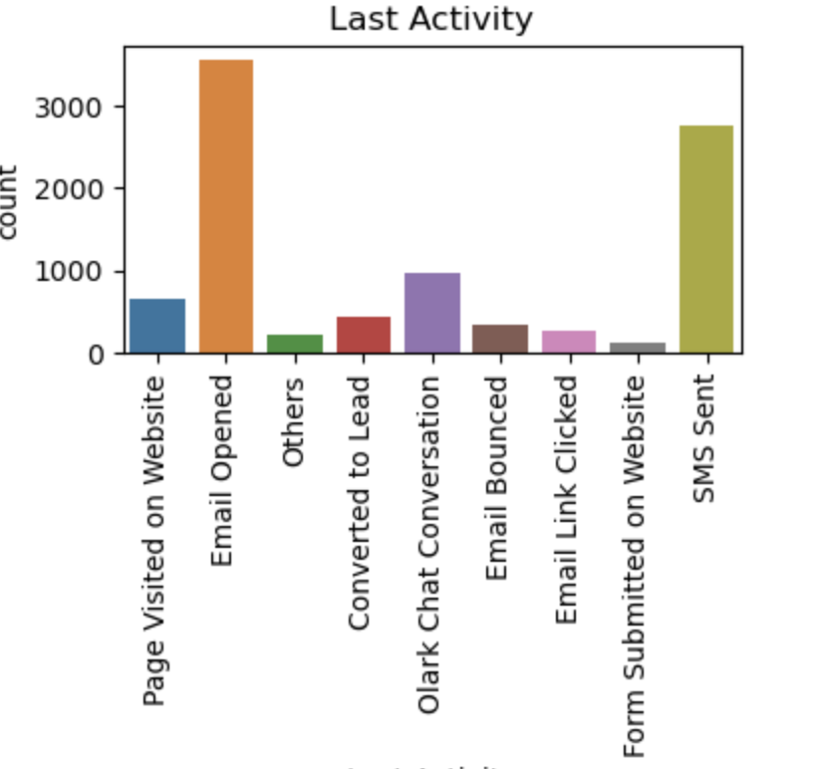
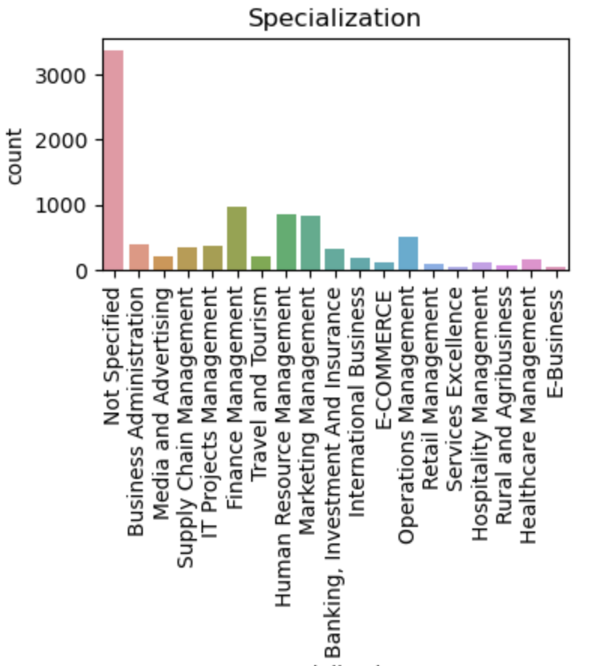
Univariate Analysis

Slide 8
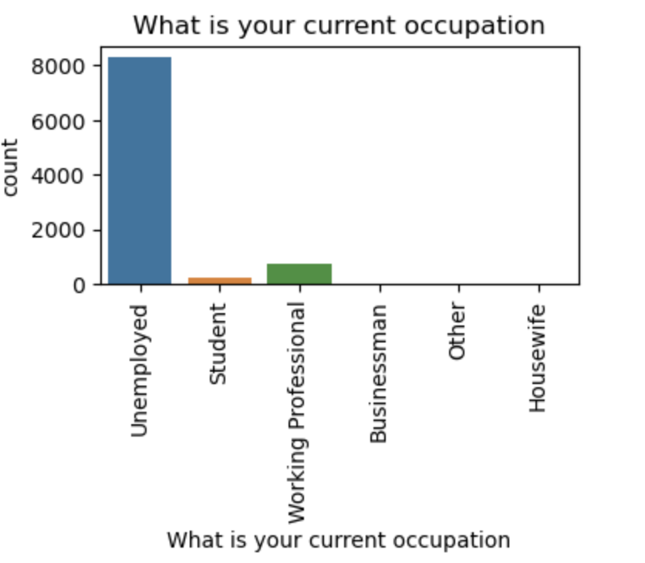
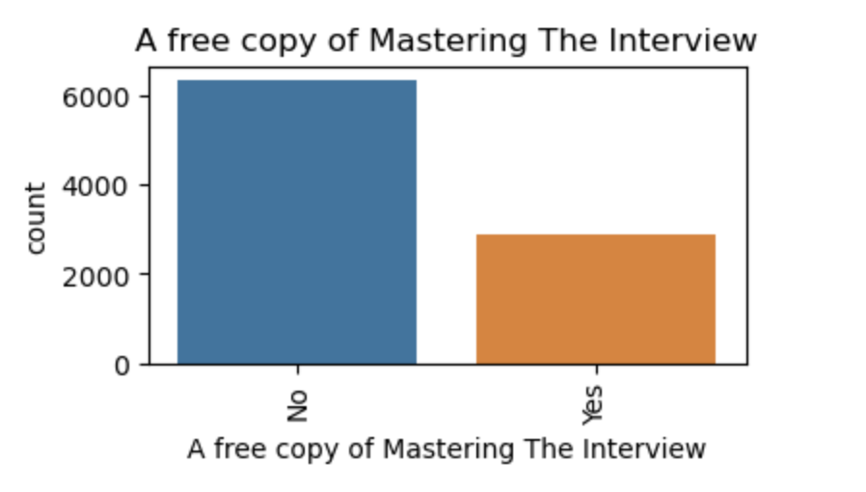
Univariate Analysis

Slide 9
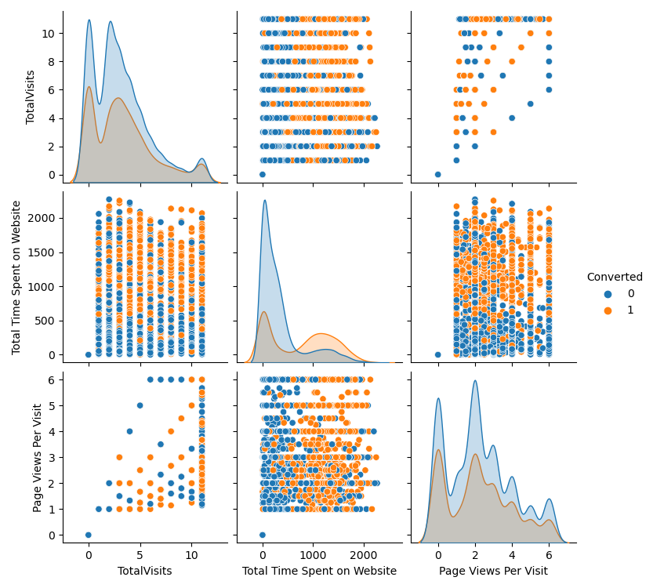
Bivariate Analysis

Slide 10
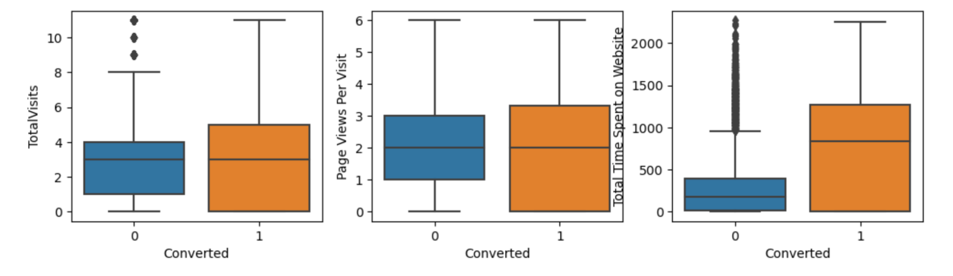
Bivariate Analysis

Slide 11
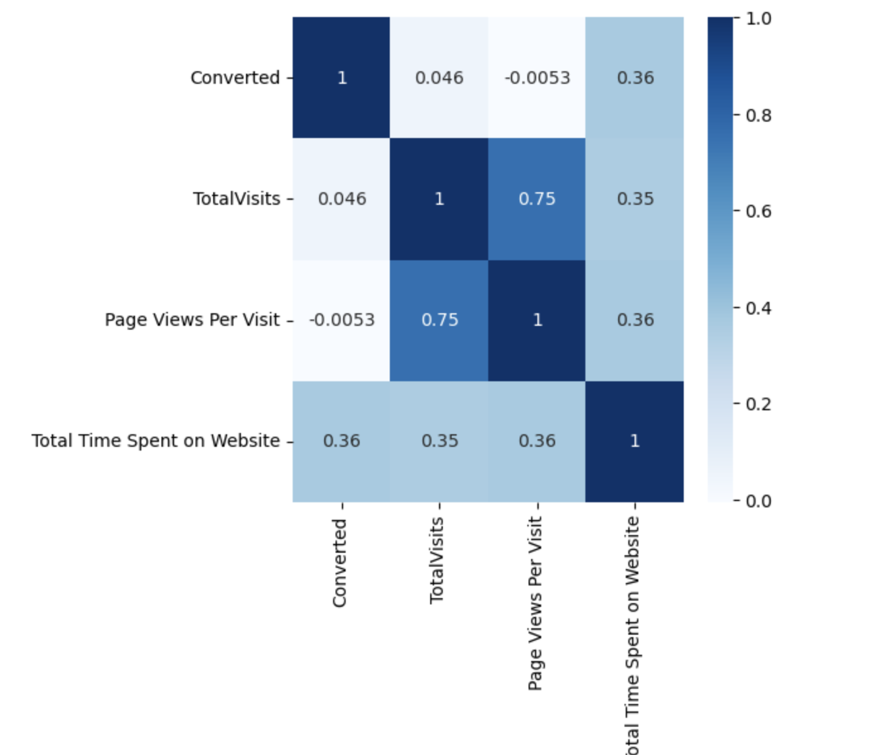
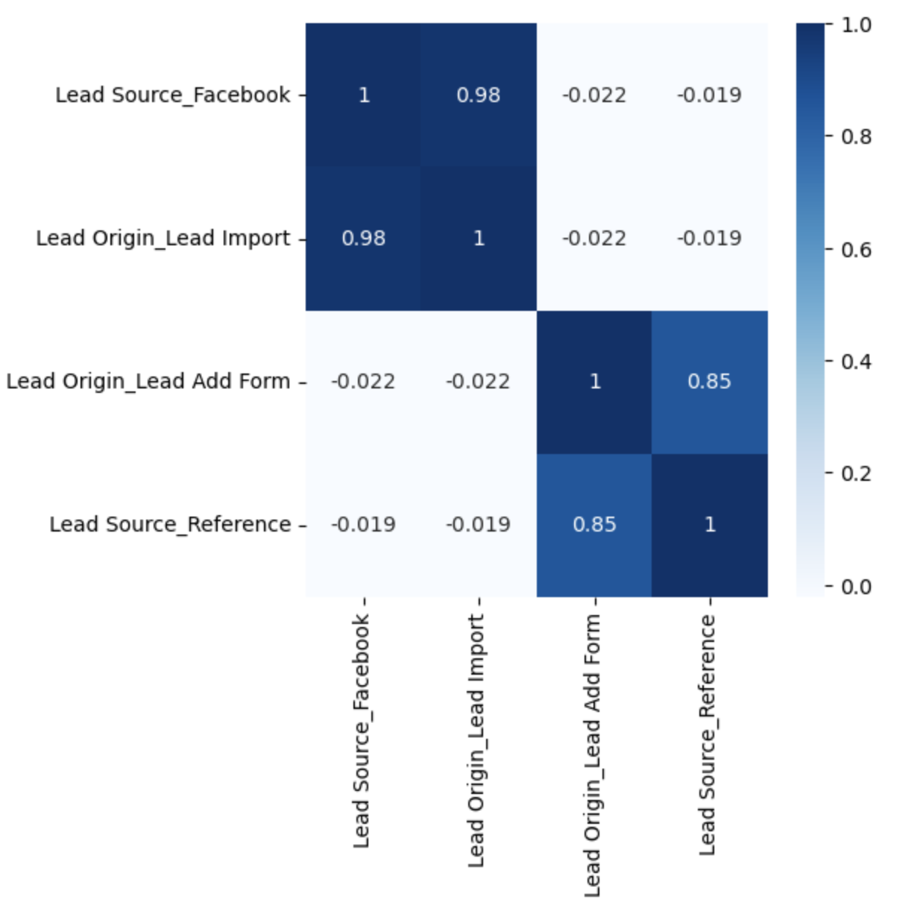
Multivariate Analysis

Slide 12
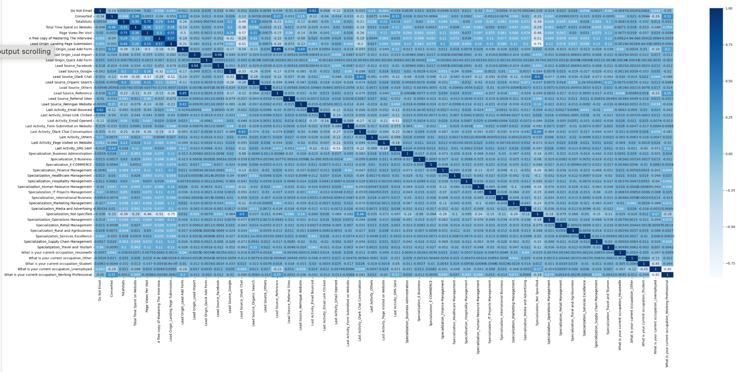
Multivariate Analysis

Slide 13
Solution Methodology
Data Preparation
Convert binary variables (Yes/No) to 0/1.
Create Dummy Variables.
Train-Test split
Split data into 2 sets : Train & Test.
Feature Scaling
Use MinMaxScaler for data standardization for numeric columns.
Drop variables which are highly correlated.
Model Building
Use Logistic Regression.
Use RFE to select the top 15 relevant variables.
Later the rest of the variables will remove manually depending on the p-value & VIF values.(The variables with VIF < 5 & p-value < 0.05).
Use final model for making prediction on Train & Test set.

Slide 14
Solution Methodology
Model Evaluation
With the 0.41 cut off Precision around 75% and Recall around 76%.
Precision-recall threshold cut-off at 0.41 the values in True Positive Rate, Sensitivity, Recall is dropped to around 75%, but we need it close to 80% as the Business Objective.
80% for the metrics we are getting with the sensitivity-specificity cut-off threshold at 0.35.
So, we are going with sensitivity-specificity view for our Optimal cut-off for final predictions.
Lead Score is assigned based on 0.35 cut off for Train data set.

Slide 15
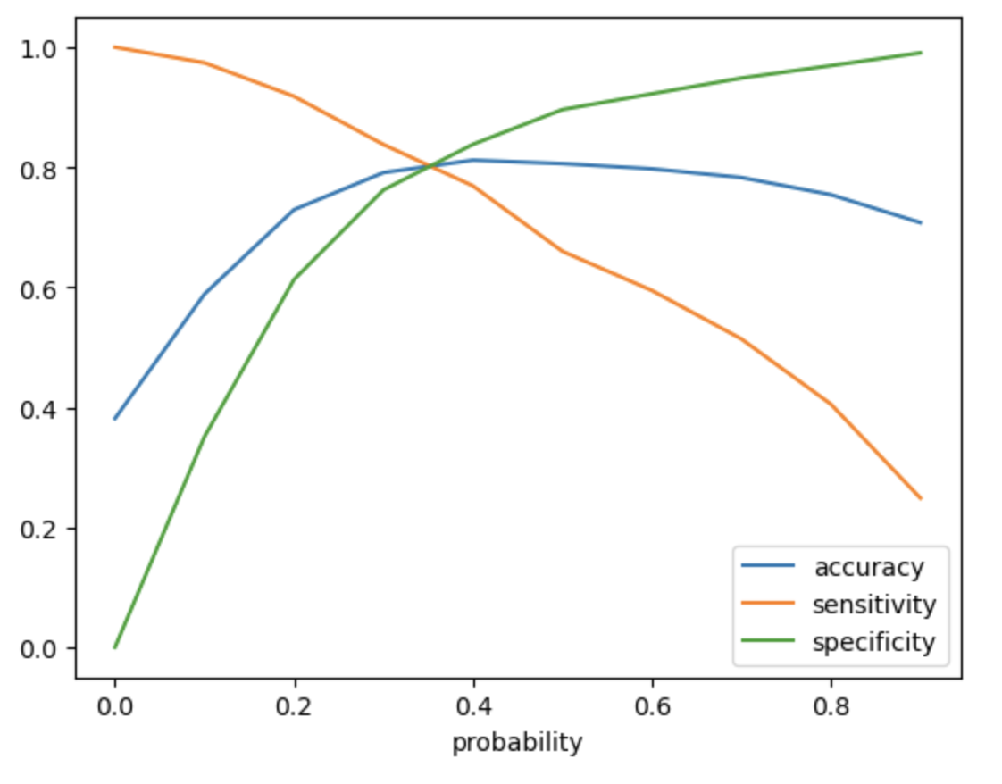
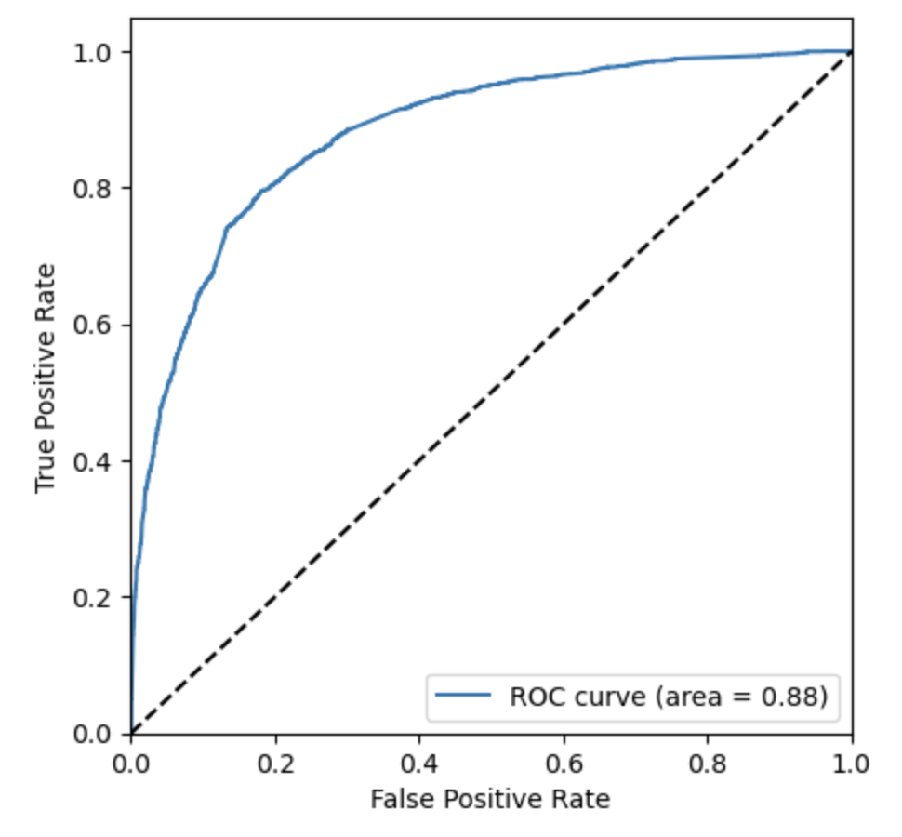
Solution Methodology
Predictions on Test Data:
Prediction is done on the test data frame and with an optimum cut off as 0.35 with accuracy, sensitivity and specificity of 80%.
Lead Score is assigned based on the 0.35 cut off for the Test data set.

Slide 16
Conclusion
The variables that mattered the most in the potential buyers are:
The total time spent on the Website.
When their current occupation is as a working professional.
When the lead source are:
a. Welingak website
b. Reference
c. Landing Page Submission
When the last activity was:
a. SMS
b. Olark chat conversation

Slide 17
Conclusion
The final Logistic Regression Model has 14 features with coefficient:
1. Lead Source_Welingak Website 5.486350
2. Lead Source_Reference 2.962948
3. What is your current occupation_Working Professional 2.638583
4. Last Activity_SMS Sent 1.931975
5. Last Activity_Others 1.406916
6. Lead Source_Others 1.078488
7. Total Time Spent on Website 1.046326
8. Lead Source_Olark Chat 0.927594
9. Last Activity_Email Opened 0.752723
10. Last Activity_Olark Chat Conversation -0.722372
11. Specialization_Hospitality Management -1.067609
12. Do Not Email -1.117864
13. Specialization_Not Specified -1.184853
14. Lead Origin_Landing Page Submission -1.214762

Slide 18
Recommandation
Focus on features with positive coefficients.
More spend can be done on Welingak Website in terms of advertising, etc.
Engage working professionals with messaging.
Incentives or discounts for providing reference that convert to lead, encourage providing more references.
Working professionals to be aggressively targeted as they have high conversion rate.
Develop strategies to attract high-quality leads from top-performing lead sources.
Analyze negative coefficients.
Review landing page submission process for areas of improvement.

